Slide 1
Courtenay Counselor

Slide 2
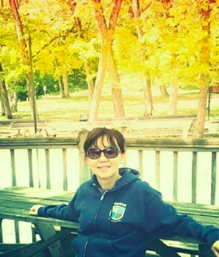
My name is Mrs. Grace Koh. My students call me Ms. Grace.

Slide 3
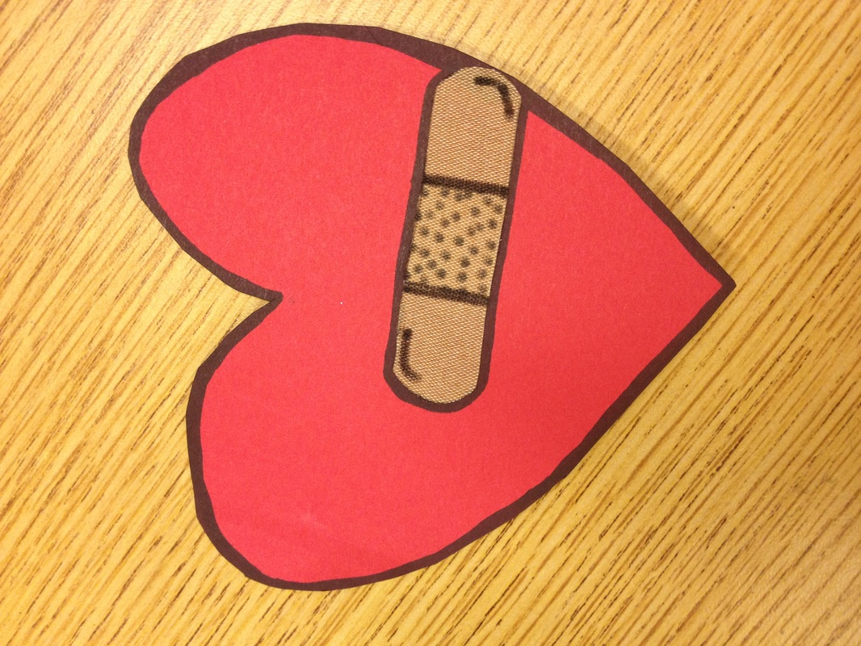
I care about every student.

Slide 4
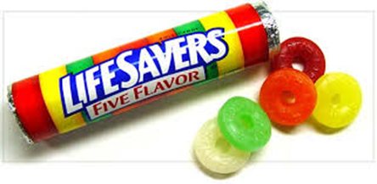
Students can see the school counselor if they need someone to talk to.

Slide 5
I help students dry their tears. It is okay to cry if you have a problem.

Slide 6
I can help when you are hurting

Slide 7
I can help solve problem.

Slide 8
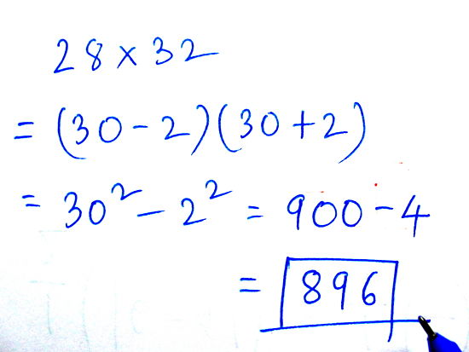

Slide 9
what the problem is and what you can do about it.
I help you decide

Slide 10
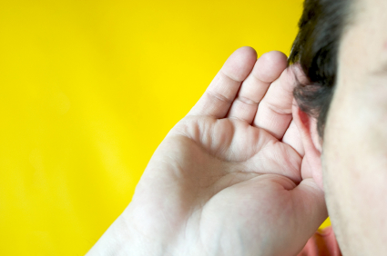
I am a Listener

Slide 11
My Office is 215. You can come to talk if you are feeling sad or upset about anything.
I listen to your problems.

Slide 12
Secret Keeper

Slide 13
unless the secret will hurt you or someone else.
I keep your secrets.

Slide 14
Everyone makes mistakes. I want to help students deal with their feelings about the mistakes they’ve made.

Slide 15
No Magic solutions. We must work together to make it better..

Slide 16
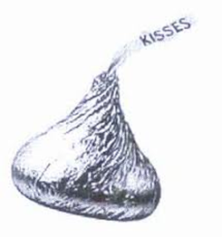
I want to help students feel better.

Slide 17
MS. Grace
Courtenay Counselor

